Slide 1
How to build a secure data strategy with azure ml
Sarbani Maiti
VP, data science at veersa technology

Slide 2
agenda

Slide 3
introduction
Security is the most important aspect of every industry. Machine Learning projects are highly dependent on data and different teams work together in various phases of the ML life cycle.
Security aspects are the biggest reasons machine learning projects get stuck. Hence it is important to build the security from the beginning rather than fixing the patches at the end.
In this session, we will understand the Azure security within a machine learning platform and how to secure the resources inside Azure ML.

Slide 4
High level areas of security
Authentication & Authorization
Network Security
Data Encryption
Policy & Monitoring

Slide 5
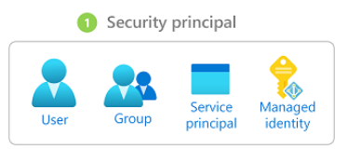
Restrict access to resources & operations
Authentication of Azure Ml Workspce is based on Azure AD
Authentication Workflows
Interactive Authentication
Use your account in active directory to another directory to authenticate or to get token that is used for authentication (per user basis)
Service principle
Where you can create a service principal account in Azure active directory, and use that to authenticate or get a token. A service principle is used when you need an automated process to authenticate to the service without requiring user interactions. For example, a CI CD pipeline.
Managed identity
Allows the VM to connect to the Workspace without storing credentials and python code or prompting the user to authenticate interactively.
Azure machine learning compute clusters can also be configured to use a managed identity to access the workspace when training models. It can communicate with services like container registry etc via these manage Keys instead of requiring admin keys

Slide 6
Use role-based Access Control( RBAC )
RBAC is used to scope the level of access allowed for the resources.
For example, an account is used to get the access token for a deployed model. Only needs read access to the workspace. This is what we call authorization

Slide 7
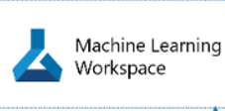
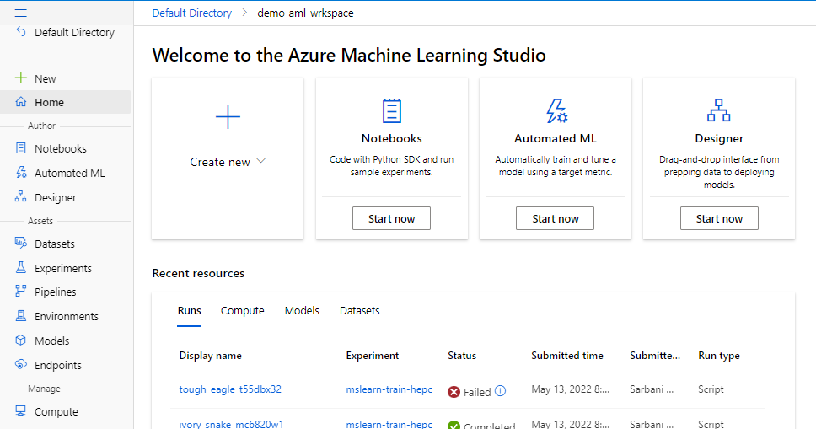
Multiple Workspaces
Multiple People
Readonly
Owner
Reader
Contributor
Need access in deployed model
Notes:
When you share a workspace, you can control access to it but aside, Signing specific roles to users. There are three built-in roles owner, contributor, and reader, of course, the roles correspond to specific rights to operations, within the workspace. Now, here's a pro tip. If the built-in trolls, don't meet your needs, you can create custom rules. These can help you define roles that are best suited for your team structures and organizational policies. Now, custom roles are supported to control all operations and the workspace, such as creating a computer submitting, a run, registering, a data store or deploying the model.
Custom rules can have read-write, or delete permissions on the various resources of a workspace such as clusters and data stores and models. And endpoints. You can make the role available at a specific workspace, level a specific Resource Group, level or even at the subscription level. These roles are used to secure its targets and data owners and contributors can use all compute targets and data stores that are attached to the workspace.

Slide 8
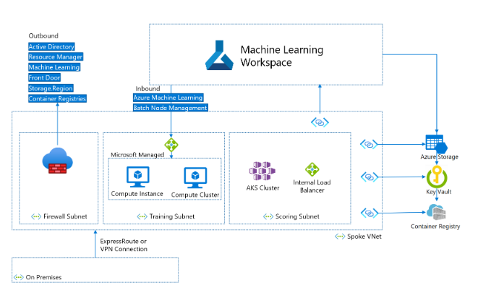
network security architecture q

Slide 9
network security architecture
The recommended machine learning network security architecture is a virtual network with the following subnets:
Training contains compute resources used for training, such as machine learning compute instances or compute clusters.
Scoring contains compute resources used for scoring, such as Azure Kubernetes Service (AKS).
Firewall contains the firewall that allows traffic to and from the public internet, such as Azure Firewall.

Slide 10
network security architecture Virtual network
The virtual network also contains a private endpoint for your machine learning workspace, and the following dependent services:
Azure Storage account
Azure Key Vault
Azure Container Registry

Slide 11
network security architecture outbound communication
Outbound communication from the virtual network must be able to reach the following Microsoft services:
Machine learning
Azure Active Directory (Azure AD)
Azure Container Registry, and specific registries that Microsoft maintains
Azure Front Door
Azure Resource Manager
Azure Storage

Slide 12
Virtual network and private endpoint design
Remote clients connect to the virtual network by using either Azure ExpressRoute or a virtual private network (VPN) connection.
create separate subnets for training and scoring, and use the training subnet for all private endpoints.
For IP addressing, compute instances need one private IP each.
Compute clusters need one private IP per node.
AKS clusters need many private IP addresses. A separate subnet for at least AKS helps prevent IP address exhaustion.

Slide 13
Virtual network and private endpoint design
The compute resources in the training and scoring subnets need to access the storage account, the key vault, and the container registry.
We have to create private endpoints for the storage account, the key vault, and the container registry.
Machine learning workspace default storage needs two private endpoints, one for Azure Blob Storage and another for Azure File Storage.
If you use Azure Machine Learning studio, the workspace and storage private endpoints should be in the same VNet.
If you have multiple workspaces, use a virtual network for each workspace to create an explicit network boundary between workspaces.
Notes:
We may use a virtual private Network or VPN gateway to connect individual client on our own network to the v-net, but network security is not only about putting the ml workspace inside a, V-net.
A machine learning environment, typically, interacts with a bunch of other services, like storage, container registry, kubernetes Services, Etc. We should ensure that these Services can also communicate securely with the machine learning workspace. This is where private link comes in Azure machine. Learning workspace can use as your private link to create a private end point behind the v-net.
This provides a set of private IP addresses that can be used to access the workspace from within the v-net, some of the services that Azure machine learning relies on can also use Azure private link, but some rely on network, security groups or user-defined routing.

Slide 14
Use private IP addresses
Private IP addresses minimize your Azure resources' exposure to the internet.
Machine learning uses many Azure resources, and the machine learning workspace private endpoint isn't enough for end-to-end private IP.
This private IP also sometimes referred to as no public IP is a must-have for a lot of Enterprises to ensure.
There's nothing open to the public internet Azure machine. Learning provides the capabilities to ensure end-to-end private IP deployments for your machine learning environments with v Nets and Azure private link.
The Azure machine learning team has a dedicated arm template with an Azure quick starts templates that deploys.

Slide 15
Control virtual network inbound and outbound traffic
Use a firewall or Azure network security group (NSG) to control virtual network inbound and outbound traffic.

Slide 16
Data security
As part of the machine learning process, we bring in data from a variety of sources and register them as data stores or data sets. All this data can be encrypted by customer managed keys.
But while these sources may have their own security capabilities, when they interact with Azure machine learning and share data to be processed inside its workspace there's a need for encryption both at rest and in transit.
ML system ingest data from a variety of sources and register them as data stores or data sets.

Slide 17
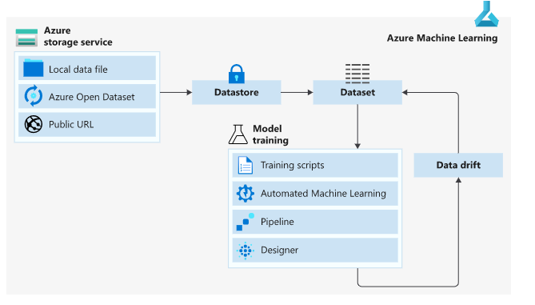
Data delivery workflow in azure secured workspace

Slide 18
Secure data access in Azure Machine Learning
Azure Machine Learning makes it easy to connect to your data in the cloud. It provides an abstraction layer over the underlying storage service, so you can securely access and work with your data without having to write code specific to your storage type.
Azure Machine Learning also provides the following data capabilities:
Interoperability with Pandas and Spark DataFrames
Versioning and tracking of data lineage
Data labeling
Data drift monitoring

Slide 19
Connect to storage with datastores
Azure Machine Learning datastores securely keep the connection information to the data storage on Azure, so we don't have to code it in the scripts.
Register and create a datastore to easily connect to the storage account, and access the data in underlying storage service.

Slide 20
Supported cloud-based storage services in Azure that can be registered as datastores:
Azure Blob Container
Azure File Share
Azure Data Lake
Azure Data Lake Gen2
Azure SQL Database
Azure Database for PostgreSQL
Databricks File System
Azure Database for MySQL

Slide 21
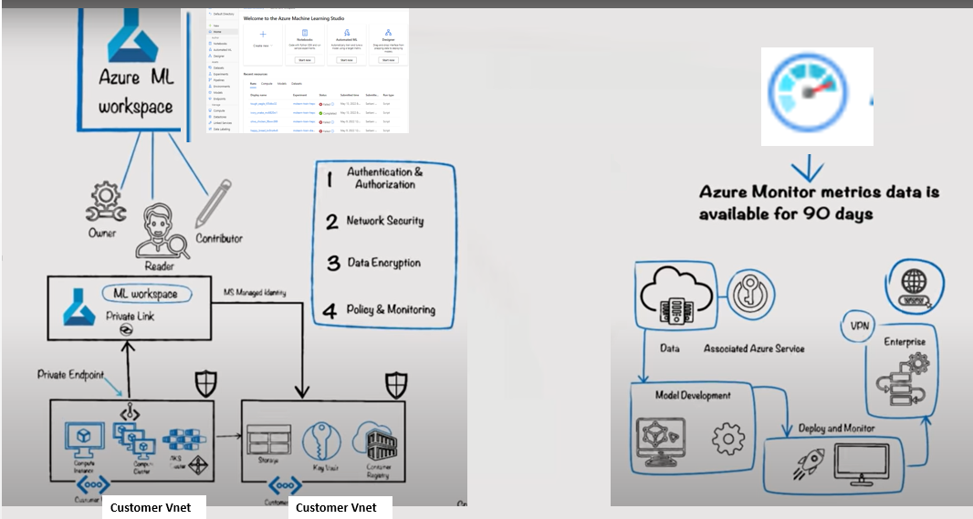

Slide 22
Self-service pattern
Define Azure policies to set safeguards for resource provisioning and usage, such as allowed cluster sizes and VM types.
Create a resource group for holding the workspaces, and grant data scientists a Contributor role in the resource group.
Data scientists can now create workspaces and associate resources in the resource group in a self-service manner.
To access data storage, create user-assigned managed identities, and grant the identities read-access roles on the storage.
When data scientists create compute resources, they can assign the managed identities to the compute instances to gain data access.
Notes:
https://docs.microsoft.com/en-us/azure/cloud-adoption-framework/ready/azure-best-practices/ai-machine-learning-enterprise-security

Slide 23
Data-centric pattern
Create the workspace.
Create compute resources with system-assigned managed identities enabled.
When a data scientist needs access to the data for a given project, grant the compute managed identity read access to the data.
Grant the compute managed identity access to any other required resources, such as a container registry with custom Docker images for training.
Also grant the workspace's managed identity read-access role on the data, to enable data preview.
Grant the data scientist access to the workspace.
The data scientist can now create data stores to access data required for projects, and submit training runs that use the data.

Slide 24
Project-centric pattern
Create the workspace
Identify data storage instances required for the project, create a user-assigned managed identity, and grant the identity read access to the storage.
Optionally, grant the workspace's managed identity access to data storage to allow data preview. You can omit this access for sensitive data not suitable for preview.
Create credential-less data stores for the storage resources.
Create compute resources within the workspace, and assign the managed identity to the compute resources.
Grant the compute managed identity access to any other required resources, such as a container registry with custom Docker images for training.
Grant data scientists working on the project a role on the workspace.

Slide 25
Demo : Secure data access in Azure Machine Learning using DataStore and Dataset
How to Create an Azure Machine Learning datastore to store connection information to Azure storage.
From that datastore, create an Azure Machine Learning dataset to point to a specific file(s) in underlying storage.
To use that dataset in machine learning experiment
Mount it to your experiment's compute target for model training.
I will be using Azure ML SDK and run the demo in my local Jupyter Notebook

Slide 26
How to create a secure workspace
There is a step by step guide provided in this link
https://docs.microsoft.com/en-us/azure/machine-learning/tutorial-create-secure-workspace

Slide 27
How to create a secure workspace –Steps
Create an Azure Virtual Network (VNet) to secure communications between services in the virtual network.
Create an Azure Storage Account (blob and file) behind the VNet. This service is used as default storage for the workspace.
Create an Azure Key Vault behind the VNet. This service is used to store secrets used by the workspace. For example, the security information needed to access the storage account.
Create an Azure Container Registry (ACR). This service is used as a repository for Docker images. Docker images provide the compute environments needed when training a machine learning model or deploying a trained model as an endpoint.

Slide 28
How to create a secure workspace –contd.
Create an Azure Machine Learning workspace.
Configure Azure Machine Learning studio to work behind a VNet. The studio provides a web interface for Azure Machine Learning.

Slide 29
Other services (not used in demo)
Create a jump box. A jump box is an Azure Virtual Machine that is behind the VNet. Since the VNet restricts access from the public internet, the jump box is used as a way to connect to resources behind the VNet.
We can Create an Azure Machine Learning compute cluster. A compute cluster is used when training machine learning models in the cloud. In configurations where Azure Container Registry is behind the VNet, it is also used to build Docker images.
Connect to the jump box and use the Azure Machine Learning studio.

Slide 30
THANK YOU

